Slide 1
Brain Basics: Classroom Strategies Supporting Executive Function
OAESA
June 17, 2024
2:20 – 3:20 PM
Margaret Searle
Marilyn Swartz
searle@bex.net
marilynswartz@hotmail.com
1919 Ottawa Lane, Perrysburg, Ohio 43551
margaretsearle.com
419-874-9505

Slide 3
People with immature executive skills struggle with problem solving and are often labeled unmotivated, lazy or scatter-brained.
What they really need is support with executive function skills.

Slide 4
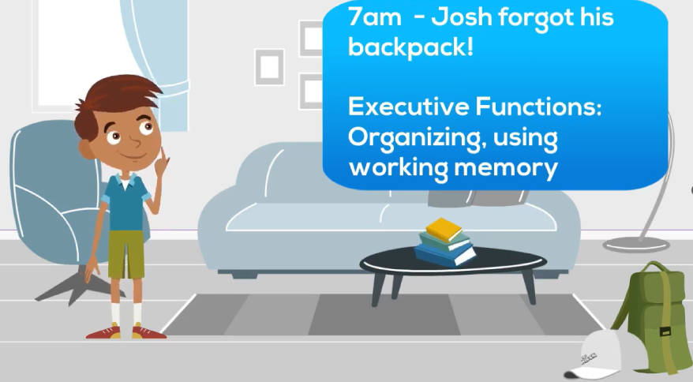
Organization involves: * Seeing patterns * Making choices * Forming habits
Organize my stuff
Organize my time
Organize my ideas

Slide 5
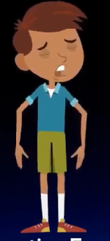
Organization Allows Us To…
1. Feel more in control
2. Make better decisions
and predictions
3. Be more productive
4. Experience less stress and
have fewer meltdowns
Dr Joel I. Kimmel

Slide 6
Setting Priorities

Slide 7
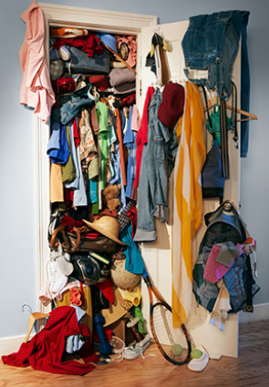
Pareto Principle (Less Is More)
For most people, this is true…
You wear 20% of your clothes 80% of the time.

Slide 8
Pareto Principle
20% of your day is when you are the most mentally productive (Which 5 hours work best for you?).
20% of your textbook contains 80% of what will be on the exam.
20% of your students cause 80% of your stress.

Slide 9
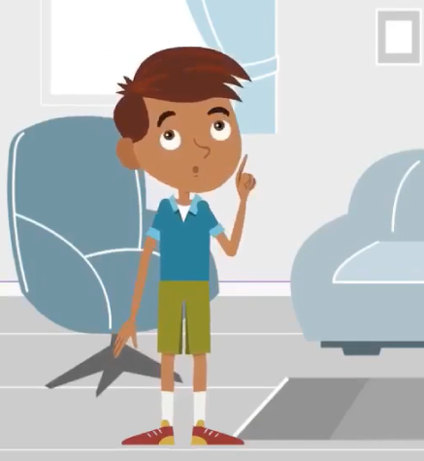
Teaching Josh the Pareto Principle (Prioritize)
Josh and his classmates could...
Make a list of the key ideas covered during class. Circle the 20% that are most important.
Choose the 20% of things that you really need in your backpack and remove most of the rest.
Make a “To Do” list and circle the 20% that will make your life easier and happier if you focus your energy there. What is the frog that you must do first?

Slide 10
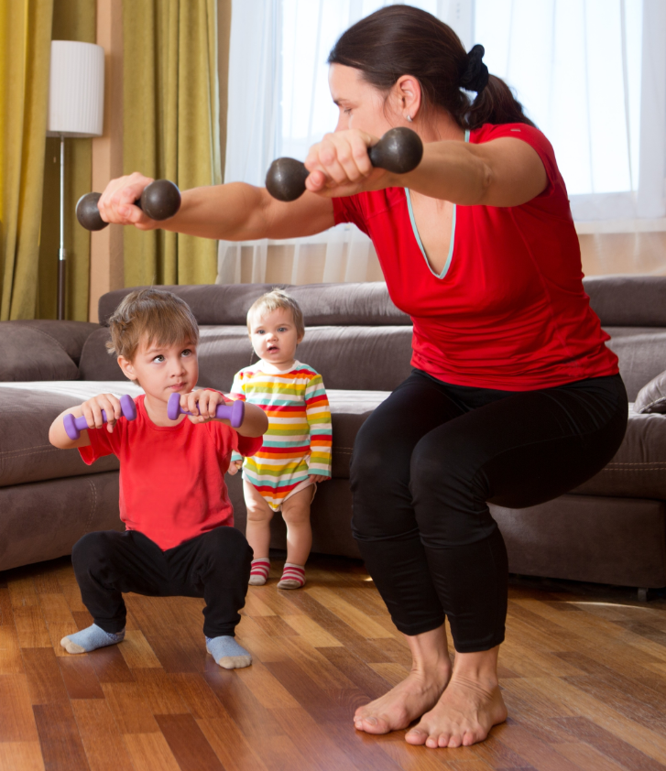
People who spend 2-5 hours a day doing things they find to be satisfying and joyful tend to be more productive... Sharif, Mogilner& Hershfield, 2021
Notes:
In short, those with fewer than two hours of free time a day feel stressed and, if possible, ought to think about rearranging their schedules to get those two hours, or a little more, to improve their sense of well-being.

Slide 11
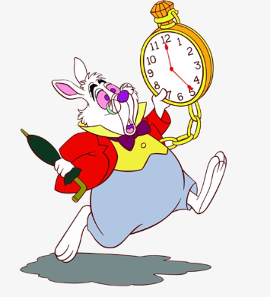
Organize Time

Slide 12
People who spend 2-5 hours a day doing things they find to be satisfying and joyful tend to be more productive... Sharif, Mogilner& Hershfield, 2021
So, how do people find the time to do that?
Pareto Principle?

Slide 13
Setting Priorities

Slide 14
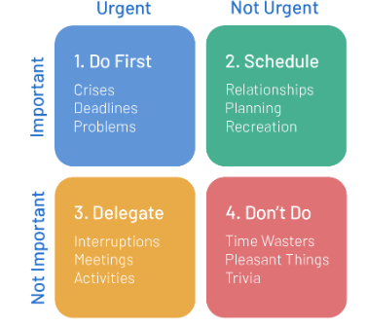
Covey’s Definition of Quadrant 1
Q1: Urgent and Important: Requires immediate attention and has a direct impact on your long-term success.
Deadline is today
Return a call to your superintendent
An injured student
Discipline problems

Slide 15
Teaching Students To Sort & Prioritize Time
Turn in assignments
Be prepared for class
Study for today’s test

Slide 16
Covey’s Definition of Quadrant 2
Q2: Not Urgent but Important: Doesn’t have tight deadlines, but significantly contributes to your joy and success. (Spend 2-5 hours a day here*)
Relationships
Hobbies
Exercise & diet
Planning & learning
Volunteering
* Sharif, Mogilner& Hershfield, 2021

Slide 17
If You Neglect Q2, Q1 Grows like Crazy
Quadrant 1
Quadrant 2

Slide 18
Teaching Students To Sort & Prioritize Time
Turn in assignments
Be prepared for class
Study for today’s test
Scheduling
Organizing
Exercise
Time with friends and family

Slide 19
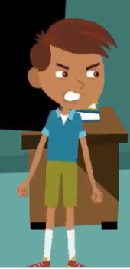
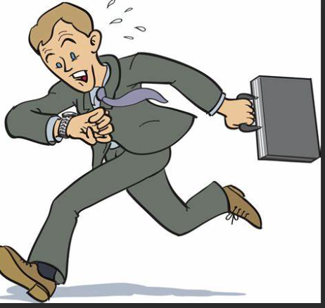
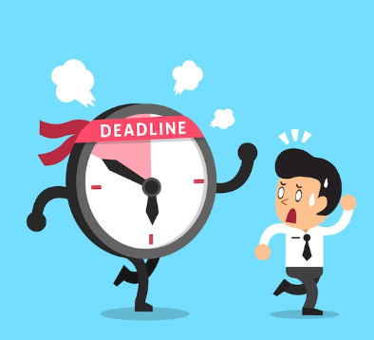
When you have poor time management skills you depend upon coincidence or luck to get you through.

Slide 20
Chart For Scheduling
Steps | In What Order?
Make my outline
Write the paper
Choose a topic
Write my draft
Read and summarize articles
Find articles

Slide 21
Chart For Scheduling
Steps | In What Order?
 | today
 | today
 | Monday
 | Soccer Tuesday
 | Wednesday
 | Thursday
Make my outline
Write the paper
Choose a topic
Write my draft
Read and summarize articles
Find articles

Slide 22
Awareness of Time
Deadlines help you feel a sense of urgency to get started.
Estimating times and setting timers help you see what’s possible.

Slide 23
Chart For Scheduling
Steps | In What Order? | Estimate | Real time | What materials or supports?
 | today | 3 min
 | today | 5 min
 | Monday | 15 min |  | Journals in media center
 | Soccer Tuesday |  |  | Note cards and computer
 | Wednesday | 15 min |  | Teacher and media specialist help on this
 | Thursday | 30 min

Slide 24
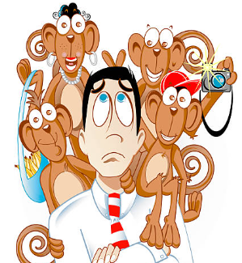
Covey’s Definition of the Quadrants
Q3: Urgent/Not Important: Demands immediate action but contributes little to long-term goals. Distracts from more important activities.
People want you to solve their problems
Meetings that make no decisions
FYI texts and calls
Discussions out of your
circle of influence

Slide 25
Teaching Students To Sort & Prioritize Time
Turn in assignments
Be prepared for class
Bring soccer shoes
Study for today’s test
Daily chores
Scheduling/tasks and time
Sorting papers into folders
Making checklists
Creating routines
Make friends
Other people’s problems
Talking between class
Shopping online

Slide 26
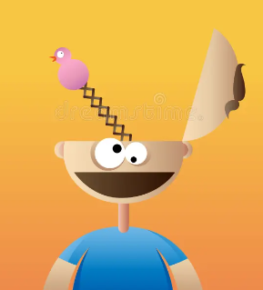
Covey’s Definition of the Quadrants
Q4: Not Urgent/ Not Important: Low-priority tasks that neither impact your long-term success nor require immediate attention.
Gossiping
Scrolling on social media
Excessive TV
Excessive anything

Slide 27
Teaching Students To Sort & Prioritize Time
Turn in assignments
Be prepared for class
Bring soccer shoes
Study for today’s test
Daily chores
Scheduling/tasks and time
Sorting papers into folders
Making checklists
Creating routines
Make friends
Solving other people’s problems
Talking to friends between class
Shopping online
Responding to gossip
Blaming
Hours of video gaming
Scrolling on the phone

Slide 28
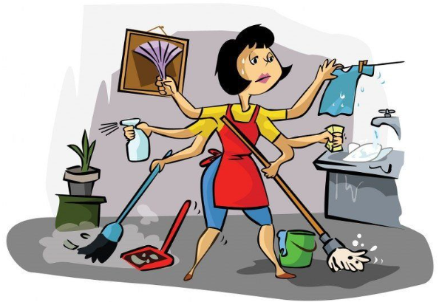
Pareto Principle
If 20% of your effort produces 80% of your meaningful results.
What should you cut out or cut down on?

Slide 29
Figuring Out Where To Spend Your Time
Plan and deliver lessons
Deal with student behavior
Return call from upset parent
Diagnosing the root causes of problems
Getting to know your students
Generating team interventions
Solving other people’s problems
Micro-managing
Admiring problems in meetings
Responding to spam
Figuring out who is to blame
Writing lots of comments on papers already graded

Slide 30
Would you ask a 10-year-old to plan your wedding?

Slide 31
Nearsightedness To Time
They live in the present so organization across time is difficult.
Can’t sequence thoughts, time or things.
Every big project becomes a crisis situation.

Slide 32
Our Internal Clock Changes
A few hours in elementary
8-24 hours in junior high
2-3 days in high school
8-12 weeks for adults
Notes:
Where’s the pay-off?

Slide 33
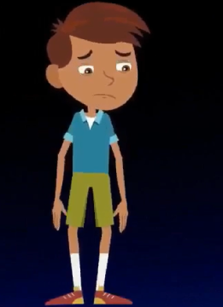
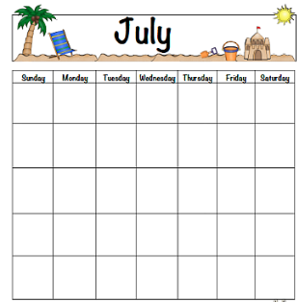
Internal Clock Is Missing?
Substitutes for visual memory:
Charts and calendars
Daily detailed checklists

Slide 34
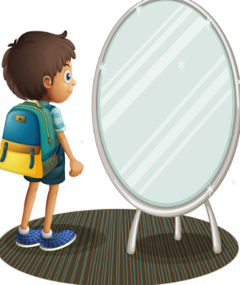
Place post-it notes on the mirror or door
Cueing Notes
Brush teeth
Get backpack
Soccer shoes

Slide 35
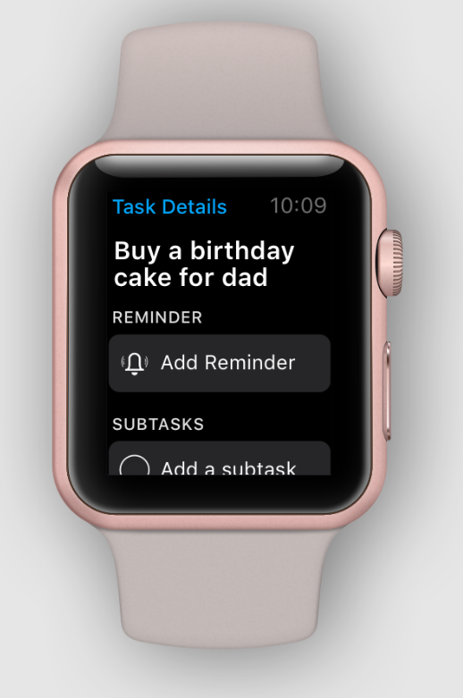
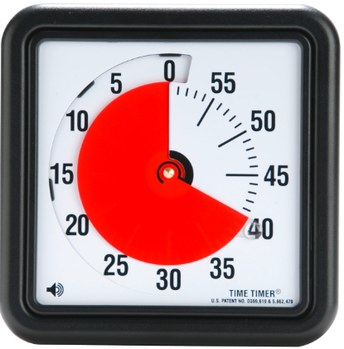
Internal Clock Is Missing?
Substitutes for memory:
Watch reminders, timers, stopwatches

Slide 36
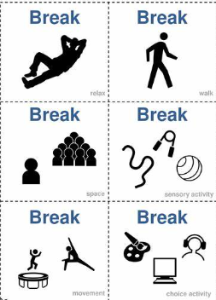
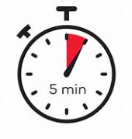
Organize
Work for… | Break options | Break for… | Remember to come back
___ minutes (Based on student’s pattern and the difficulty of the task) |  | ___minutes | Use a Timer

Slide 37
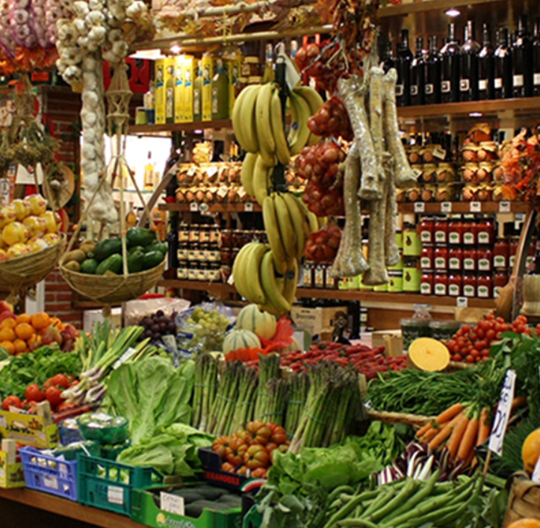
We Organize
- Things

Slide 38
How do you clean a messy closet?

Slide 39
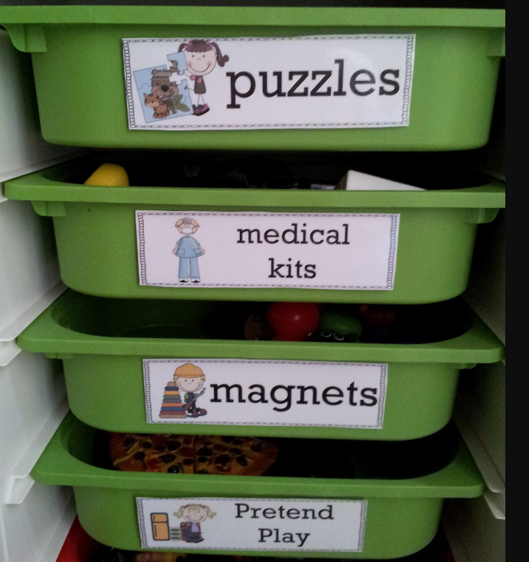
Simple & Consistent
Give everything a well-defined home
Labeled bins and drawers
Color-coded containers

Slide 40
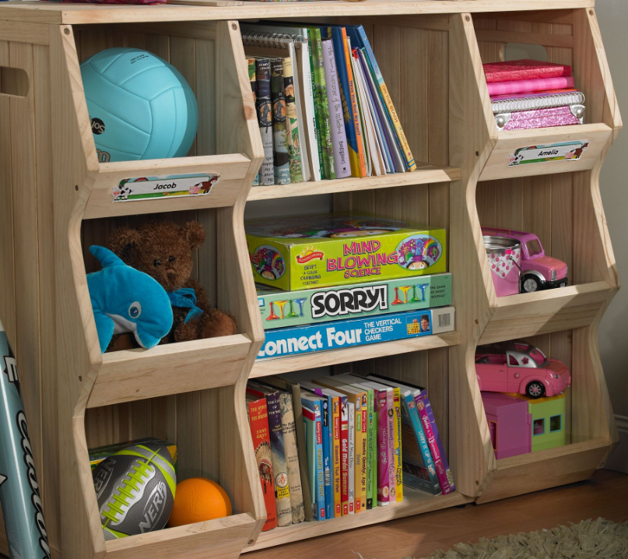
Keep It Simple & Consistent
For Young Students…
Clean-up one category at a time (books, papers, blocks,…)
Daily, predictable routines

Slide 41
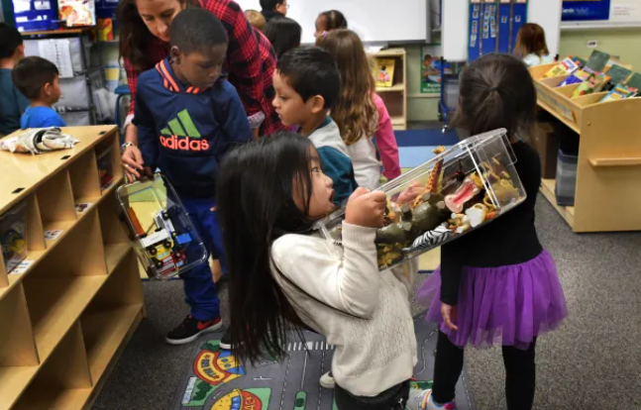
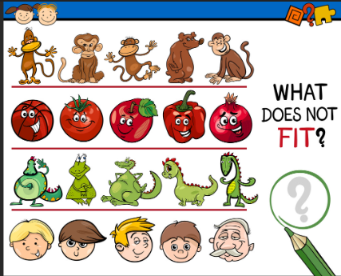
Elementary: Add Categorization
Students learn to sort
By color
By size
By function
Play “Name this group” or “What doesn’t fit”

Slide 42
For 10 + Create The System
Create and explain their rule for sorting and categorizing.

Slide 43
Teaching Sorting and Categorizing

Slide 44
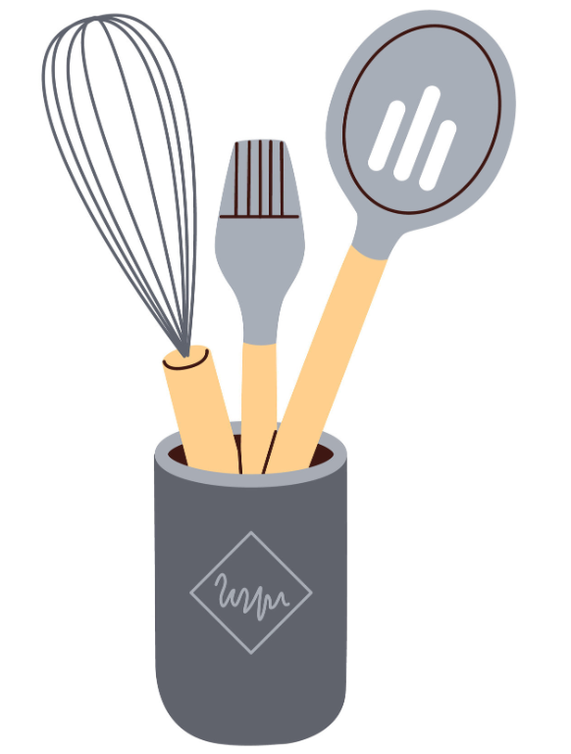
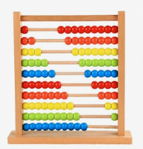
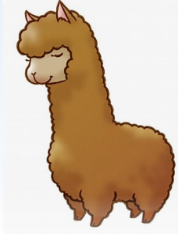
1. Divide students into groups and give each group 8 or 9 things to sort into three categories.
The Sorting Game
2. Ask the groups to write their “rules for sorting” (categories) on a
slip of paper.
Things that begin with A
Things used in the kitchen
3. Have the groups change tables and guess the three rules
(categories) created by the original team. (Answers are sealed & on the table)
4. Then rearrange the items into three new groups (categories)
for the original group to figure out.

Slide 45
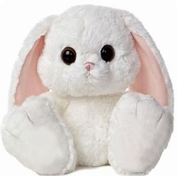
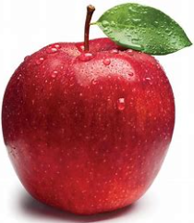
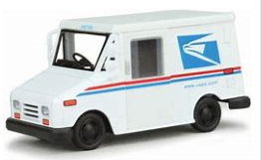
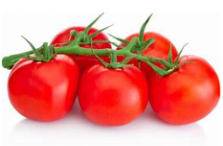
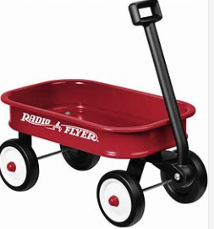
Arrange these items into three categories

Slide 46
Arrange these items into three categories
Things you could find in a purse
Toys
Things that are or have been alive

Slide 47
Arrange these items into three categories
Things that are used for market day
Animals
Thing that we use to drive

Slide 48
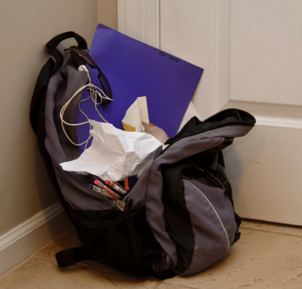
Decluttering
If you cannot see the patterns of sorting and classifying, your backpack will look like this.

Slide 49
Declutter
The more stuff you have to manage, the more stressful and difficult it is to be organized.
Pareto Principle

Slide 50
Apply the Pareto Principle
Take everything out
Sort
Things I need/ Things I do not need
Big things/small things
Science/Soc.studies/LA …
Tools
Papers I am working on
Do not put anything back that you don’t really need to carry around

Slide 51
Josh Needs To Organize - Things
- Time
- Ideas

Slide 52
Legislative Branch
How many students’ understanding of the US Constitution looks something like this . . .
Amendments
Veto power
States’ rights
Articles
Impeachment
Checks and balances
Right to vote
Right to bear arms
Executive Branch
Judicial Branch
Freedom of assembly
Silver and Strong, Thoughtful Classroom
Notes:
3 parts: preamble (general purpose)
7 Articles – specific structure of governments
Amendments – very specific changes (first 10 changes are the Bill of Rights)

Slide 53
Organization makes it more manageable

Slide 54
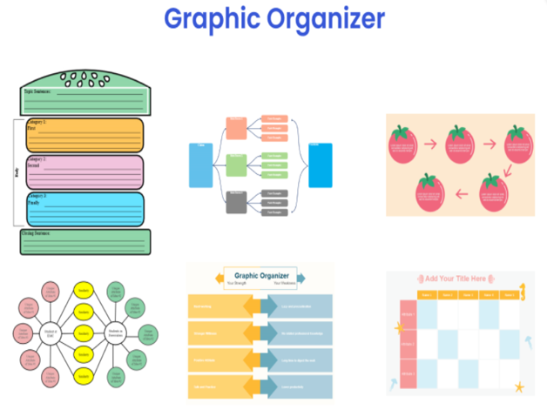
Graphic Organizers And Note Taking Strategies Help Students See Patterns Of Organization

Slide 55
Note-taking

Slide 56
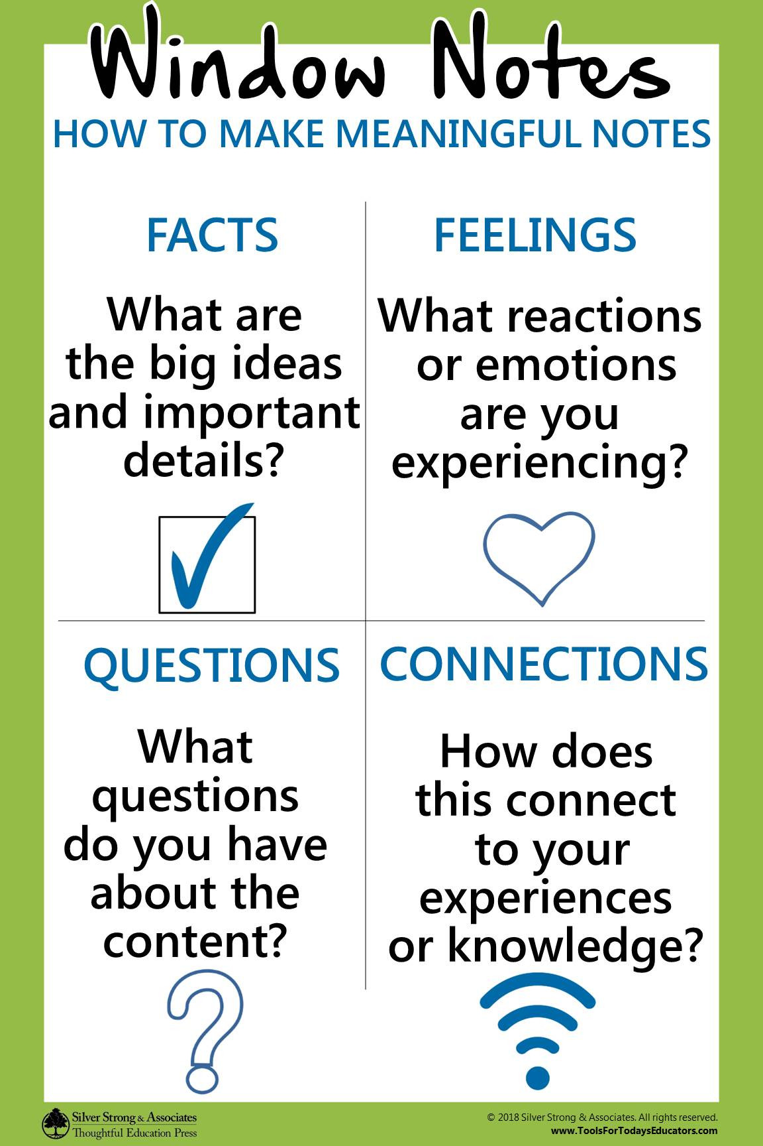

Slide 57
Let’s Summarize With Window Notes
Facts ( what you already have in place) | Feelings about teaching organization skills
Questions about teaching students to be organized | Connections How much of this do I already do? How will I integrate this into my work?
Pareto Principle
4 Quadrant Prioritizing
Sequencing Chart
Internal Clock Supports
Decluttering
KWHL
Top Hat
Window Notes

Slide 58
Organization
Sorts and Categorizes
I see and describe patterns that help me match things that go together
Sequences Materials and Ideas
I rank ideas or tasks by how important or urgent they are, to help me decide what to do next and what to put off
I sort by more than one likeness or detail
I make changes to the plan as needed so I can finish on time and with quality
Follows Through
I practice organizing things in easy ways first and then think of new ways that also could work
I have a system for double checking how well I have paid attention to and handled details
I know what strategies work for me and which ones do not
I figure out how much time is needed for each step and create a sequenced plan
I know what I want to achieve and I create a plan for how to get started
Makes Tasks Manageable
I separate things into groups and pick out things that don’t fit
I sort important from unimportant ideas and things
I look for patterns that will help me predict what comes next and I can explain what clues I used to decide
I break big tasks down into small steps to make things easier
I keep track of information and materials by using reminders and checklists
I have daily routines and procedures that help reduce my stress and find things easily and fast
I can visualize the order of steps for directions, sequence of stories or steps for decision-making
I know why it is important to organize and I see how it will help me
I know how to get help when I am stuck but I don’t depend on others too much
I describe patterns and rules for how things are alike and different
I see how organizing strategies I have used in the past can be useful in new situations.
Updated June 2024
Searle Enterprises Inc.

